Slide 1



JEANNETTE JUNIOR HIGH
JANUARY COMMUNITY TIME 8th GRADE

Slide 2
“A community is a group of people who agree to grow together.”
Simon Sinek

Slide 3

Today, we’re doing something different
8th graders are doing a class project about careers
EVERY 8th grader will be working on this project for the next week in their core classes (English, Math, Social Studies, Science)
You will pick a career of your choice
Your 2nd hour teacher gave you your Xello career match today

Slide 4
Why are we doing this?
Based on your Xello Matchmaker and conversations we’ve had with you, 8th graders are mixed in what they want to do as their career.
Many of you want careers which require college, and many of you want to pursue something that does NOT require you to go to college.

Slide 5
Why are we doing this?
Many 8th graders want to open small businesses or continue their parents
Students THINK that college is the only pathway, but it’s not
For some, it is depending on what they want to do
For others, going to college may be a waste of time and money

Slide 6
Why are we doing this?
Most importantly, we want you to understand that school is important.
It is a vital part of OPENING DOORS to you.
As a young adult, you want as many doors and pathways available for you as possible.
This means understanding how school can help you get where you want to go.
Bad grades and getting in trouble CLOSE doors to you.

Slide 7

Success in School OPENS Doors
Sports
Good Citizenship
Good Grades
Clubs
Music
Choosing the Right Classes
UBUNTU
Good Behavior
Good PSAT Scores

Slide 8

Failure in School CLOSES Doors
Inactivity
Suspensions/
Expulsions
Poor Grades
Low GPA
Putting no thought into
the classes you choose
Bullying others
Poor PSAT Scores
Arguing with adults

Slide 9
Goals of the Project
The goals of this project are as follows:
  Choose a career YOU are interested in
  Investigate and understand what it will take to achieve your career goal
  Investigate and understand how this career will impact your future lifestyle goals
  Develop a pathway to be able to successfully achieve this career
  Learn how to research a topic using reputable sources related to that topic

Slide 10
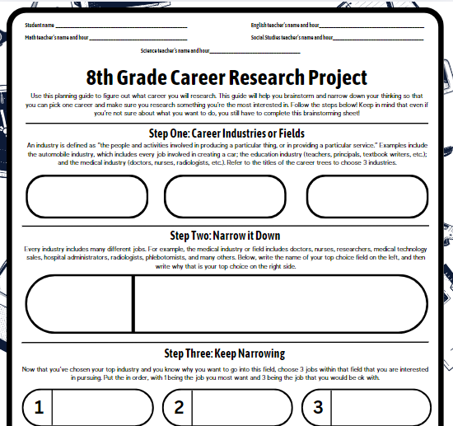
Timeline of the Project
Today – Launch
Tomorrow-Monday – English classes
  Begin by narrowing down career fields and careers and choose one
  Visit the media center or the UCS website
  to view the Career Trees
  Research using Xello and other sources
  Fill out research guide
  Turn into your English teacher, who will
  give it to your math teacher

Slide 11
Career Trees

Slide 12
Xello
Xello Link

Slide 13
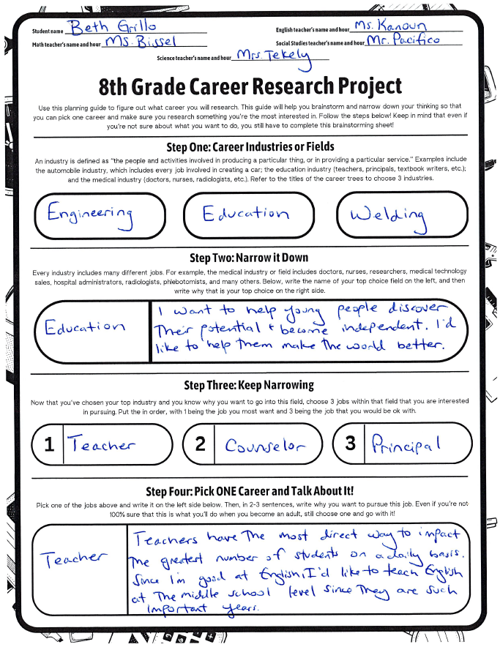
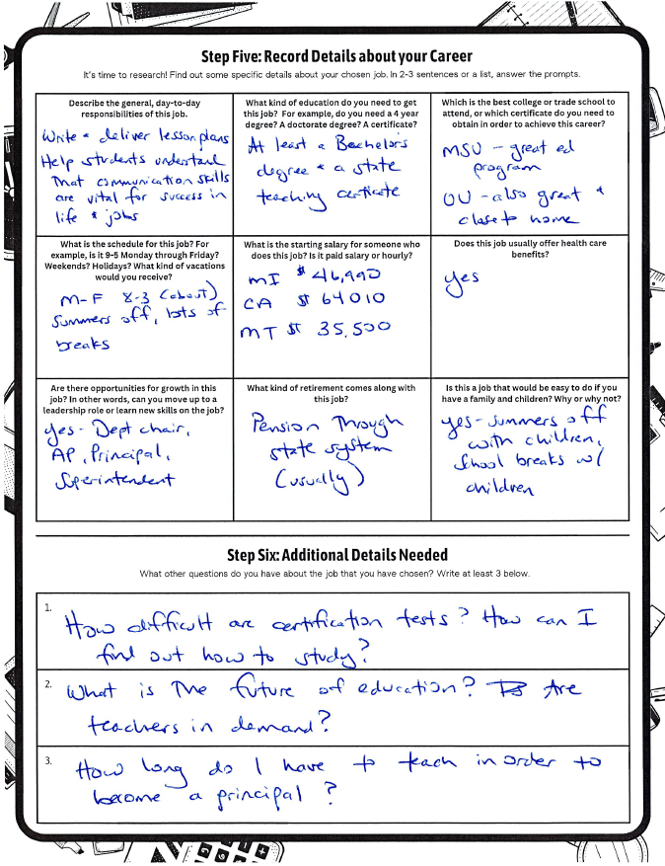
Sample of Research Guide

Slide 14
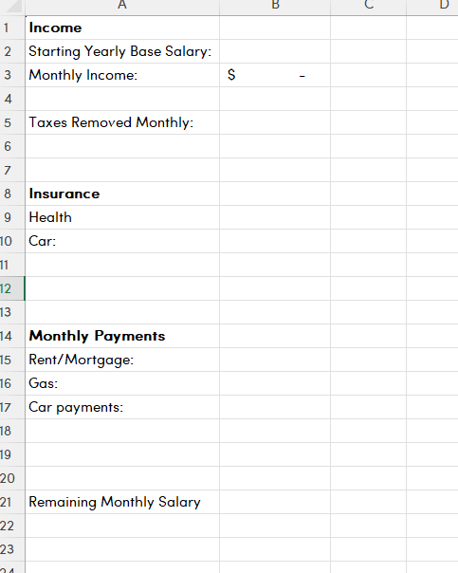
Timeline of the Project
Tuesday, February 4 – Math classes
  Fill out a budget that your teacher will provide for you
  Use the research that you did in English
  classes to figure out how this career will
  impact your lifestyle
  Ask your teachers for a realistic picture
  of adult life and how salaries impact
  your lifestyle

Slide 15
Sample Budget

Slide 16
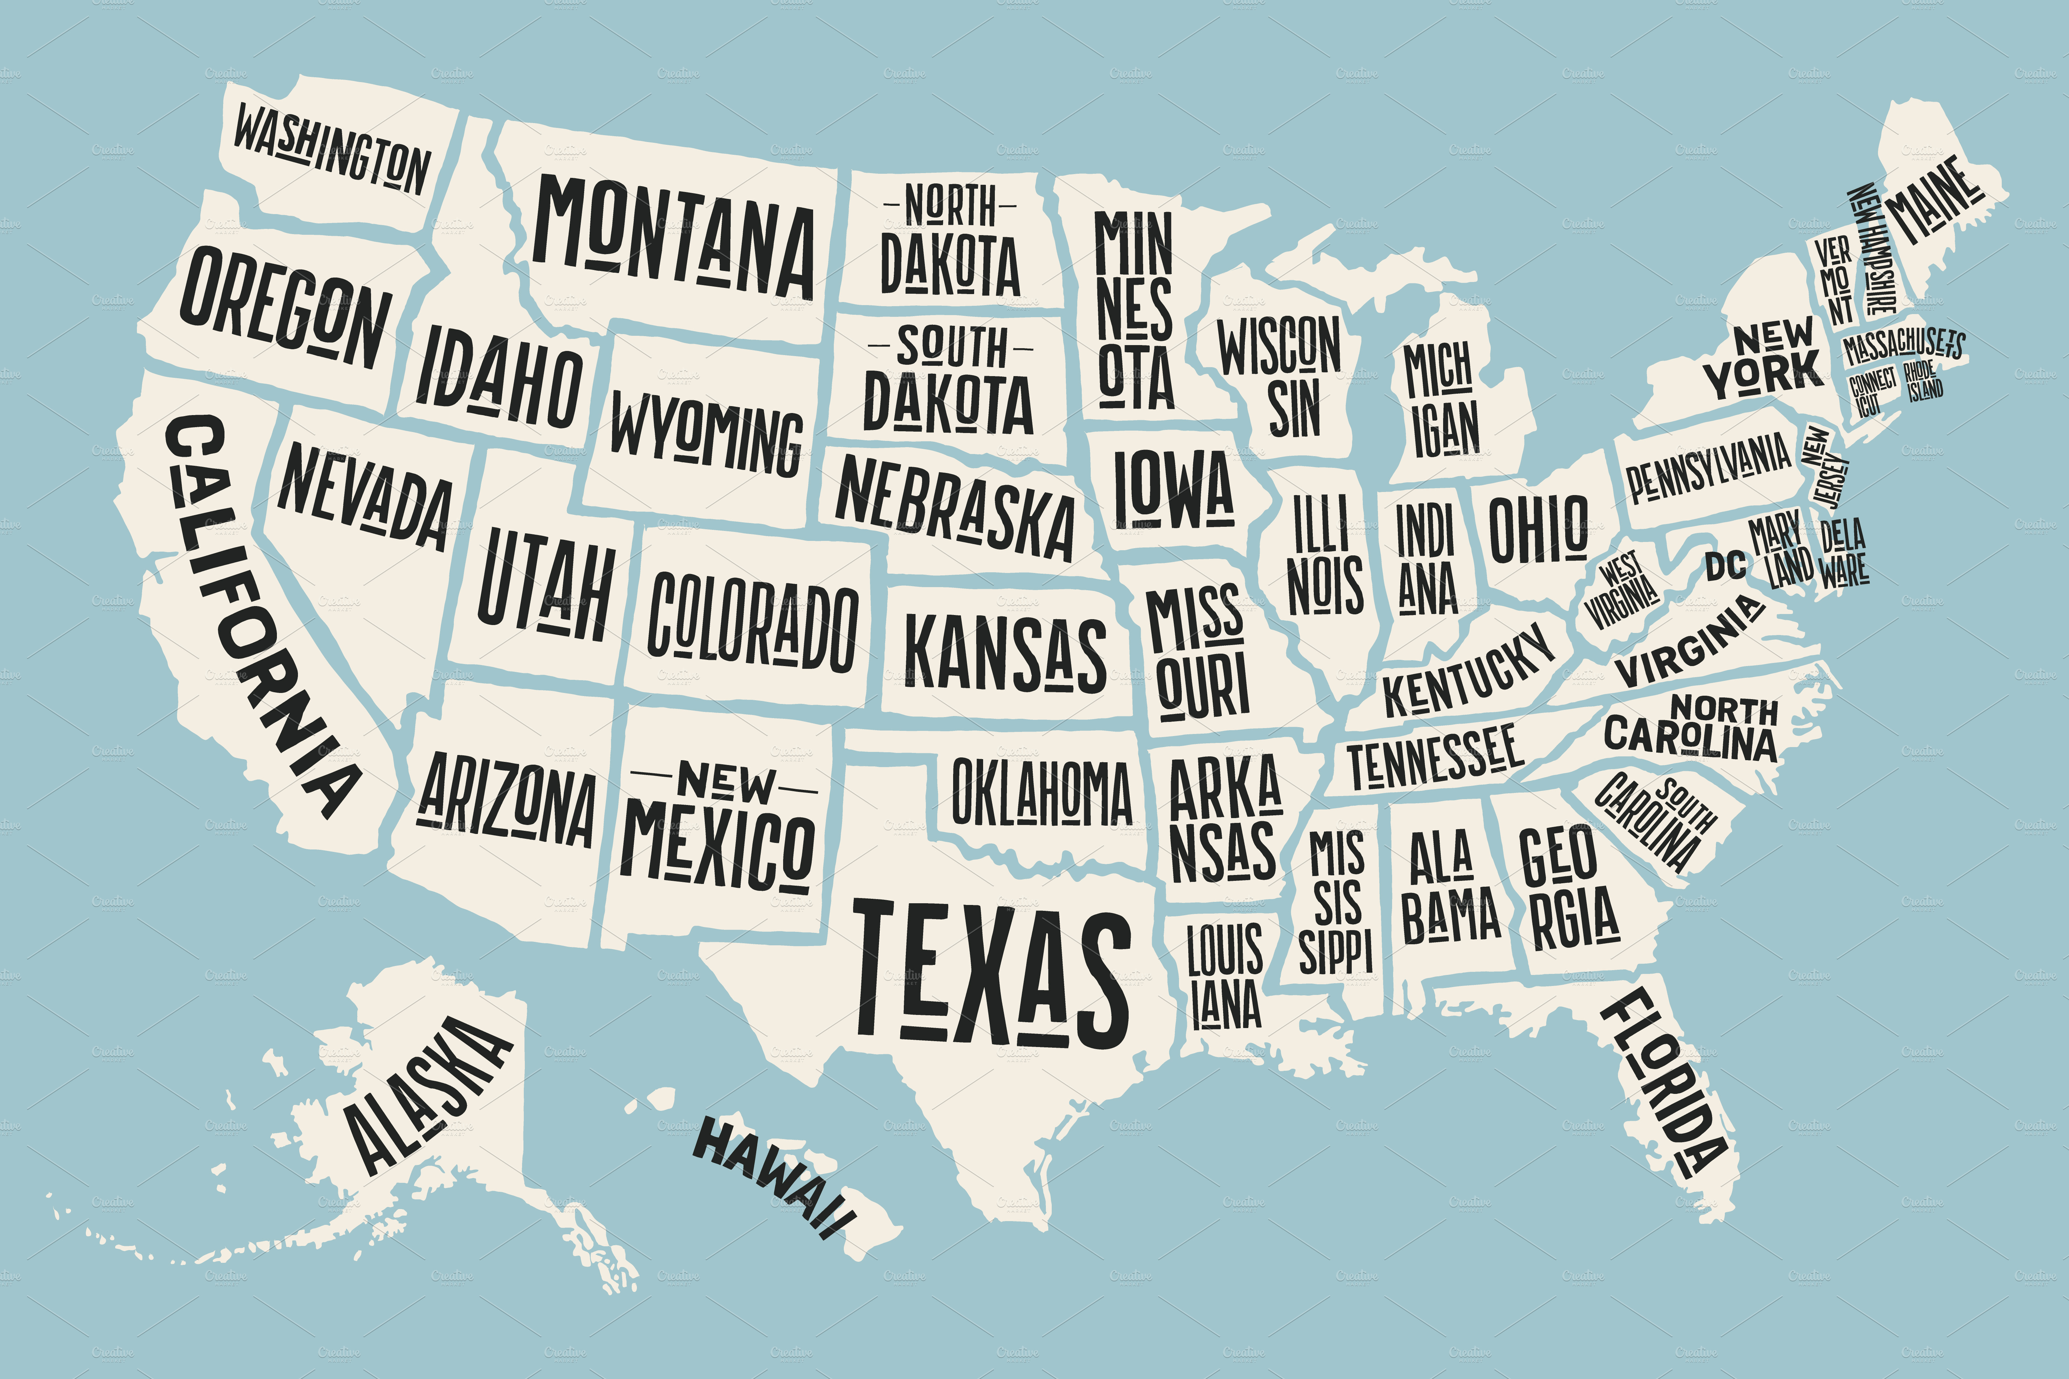
Timeline of the Project
Wednesday-Thursday, February 5-6 – Social Studies
  Investigate where in the US (or world) you could you have lifestyle you want while performing your job
  Consider things like salaries, cost of living, climate, and others
  Fill out a map as your Social Studies
  teacher guides you

Slide 17
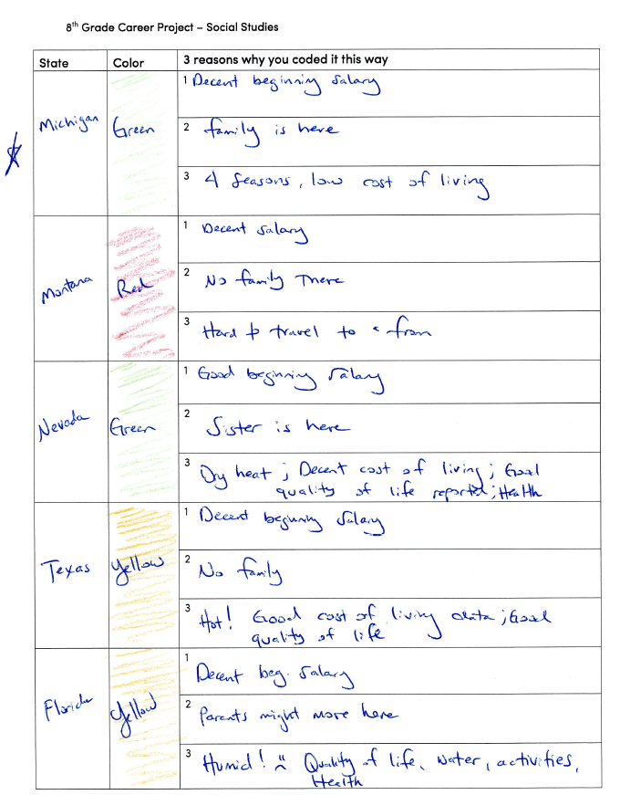
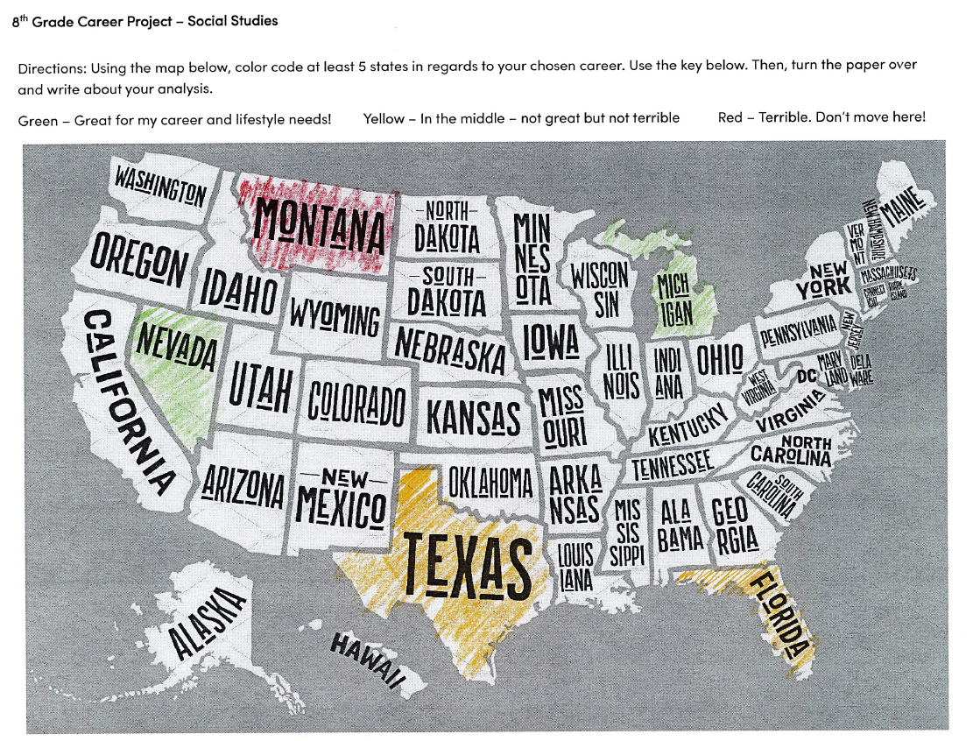
Sample Map

Slide 18
Timeline of the Project
Friday-Monday, February 7-10 – Science
  Create portfolio or presentation about your career
  Use Xello’s portfolio, PowerPoint, or Canva
  Make sure you include everything that your teacher tells you to include (it’s all on your research sheet)

Slide 19
Sample Presentation

Slide 20
Timeline of the Project
Tuesday, February 11 – Career Day

